Slide 1
Capstone Project: States and Union Territories- accidents, injuries and fatalities
By : Tanmay Upasani

Slide 2
Introduction
Per World Economic forum, India is the leader in road accidents.
Every year countless lives are lost in accidents which could've been prevented.
There are various factors that might affect a person's ability to react in such cases.
In the following investigative analysis, we try to understand the trends in number of accidents, injuries and fatalities under various applied measures.

Slide 3
Problem Statement
The ministry has handed out the data for the duration of 2016-2019 and expects us to carry out an investigative analysis to find the causes of accidents and a detailed analysis of the same.
The objective of this data analysis project is to analyze road accidents data to identify trends, factors and patterns influencing road safety.
The analysis aims to provide insights that can help in devising effective strategies to reduce accidents and improve overall road safety measures.

Slide 4
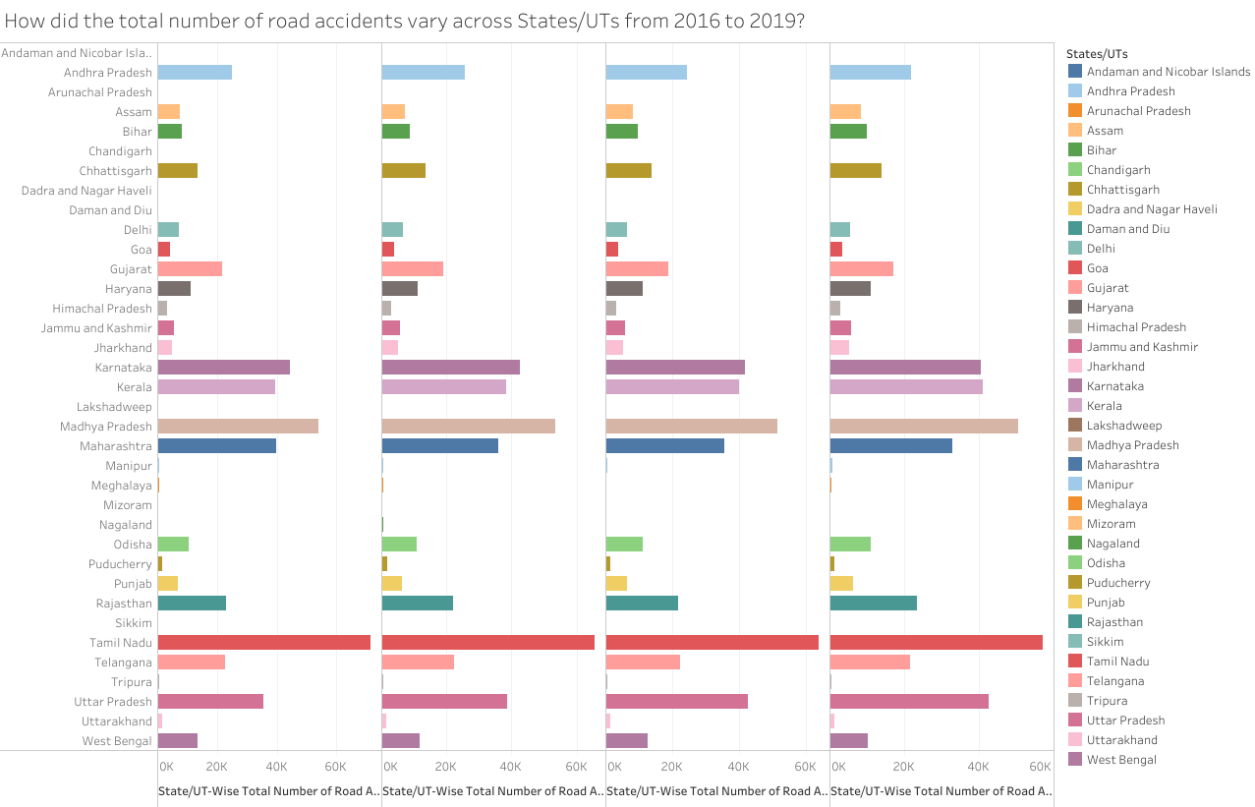
Most accidents can be found in the state of Tamil Nadu followed by Madhya Pradesh and Uttar Pradesh.
While the least can be found in the states of Arunachal Pradesh, Mizoram; UTs D&H and D&D.

Slide 5
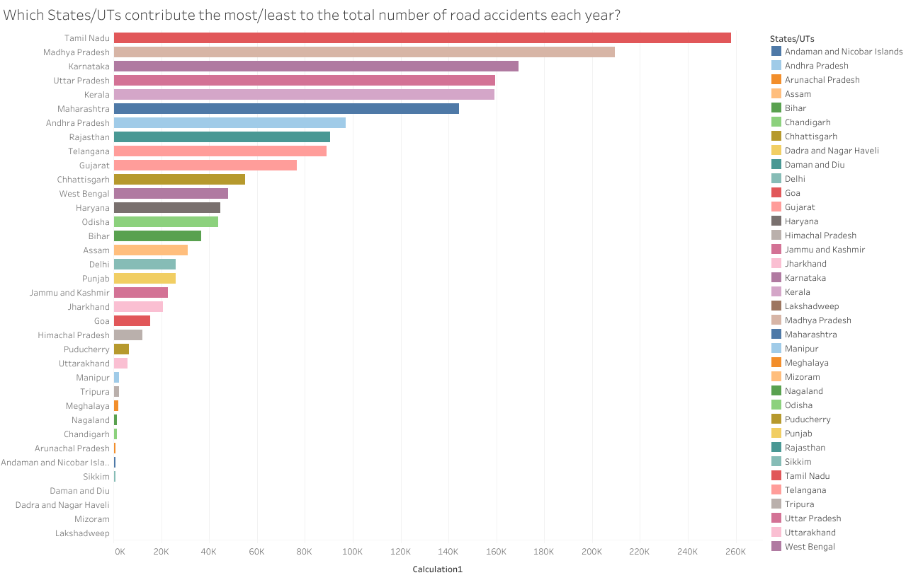
Tamil Nadu has the most accidents over a 4yr period: 2,58,141. While Lakshadweep had 6(least)

Slide 6
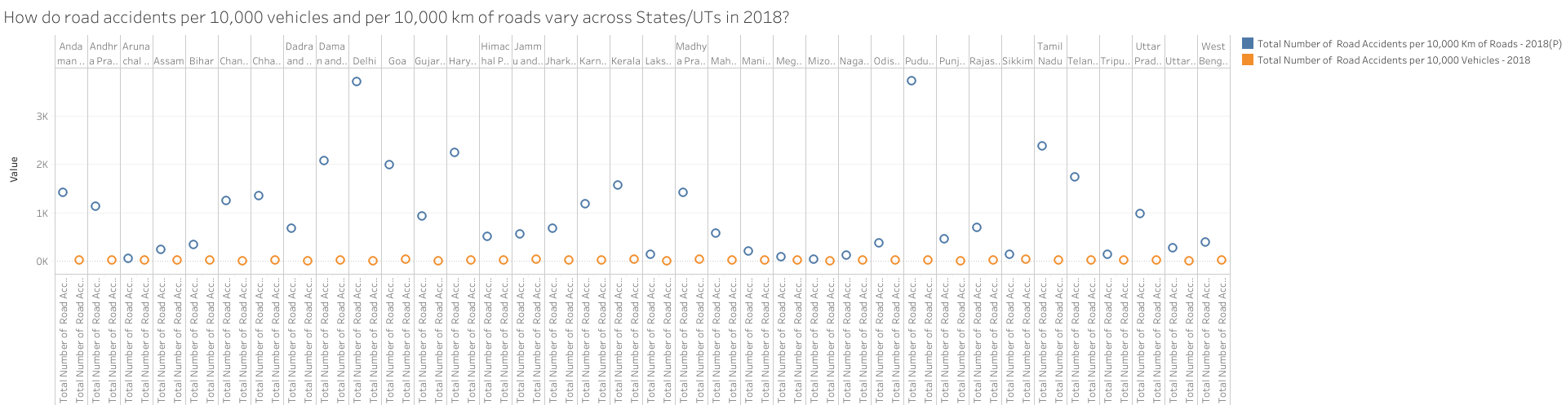
Accidents per 10,000 vehicles have been observed to be quite less in all states and Union Territories. The highest being 39 in Madhya Pradesh while the lowest number recorded was 3, in Mizoram and Chandigarh.
However, for every 10,000 km this number changes drastically. The highest recorded was 3,720 in the UT of Puducherry was 40 in Mizoram.

Slide 7
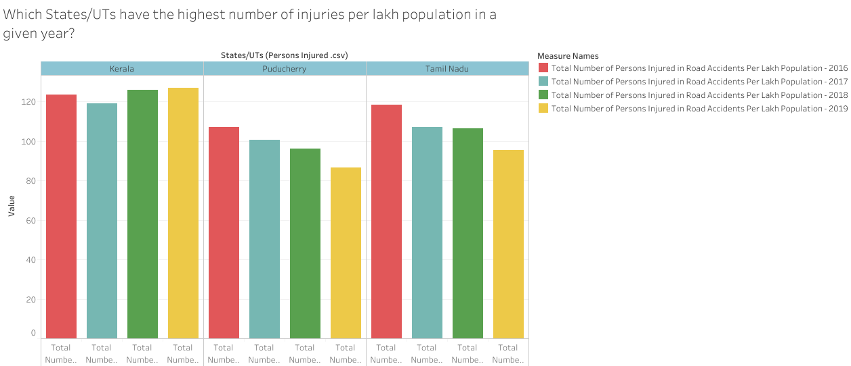
For the states Kerala tops the chart for the first time with 123.6, 119, 126.1, 127.1 respectively (all per 1,00,000) followed by Tamil Nadu with 118.4, 106.9, 106.4, 95.4.
For UTs, Puducherry is by far the highest contributor with 107, 100.5, 96.1, 86.7(All per 1,00,000).

Slide 8
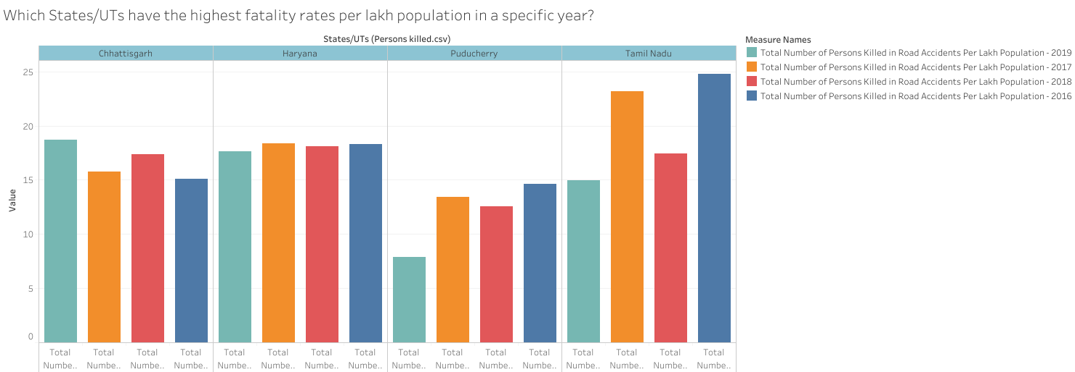
In 2016, Chhattisgarh topped the fatalities chart with 18.68 while Tamil Nadu topped in 2017 and 2019 with 23.17 and 24.81 respectively. While Haryana suffered the most in 2018 with 18.11 (All per 1,00,000).
For UTs it was once again Puducherry with 7.87, 13.44, 12.57 and 14.62 fatalities per 1,00,000.

Slide 9
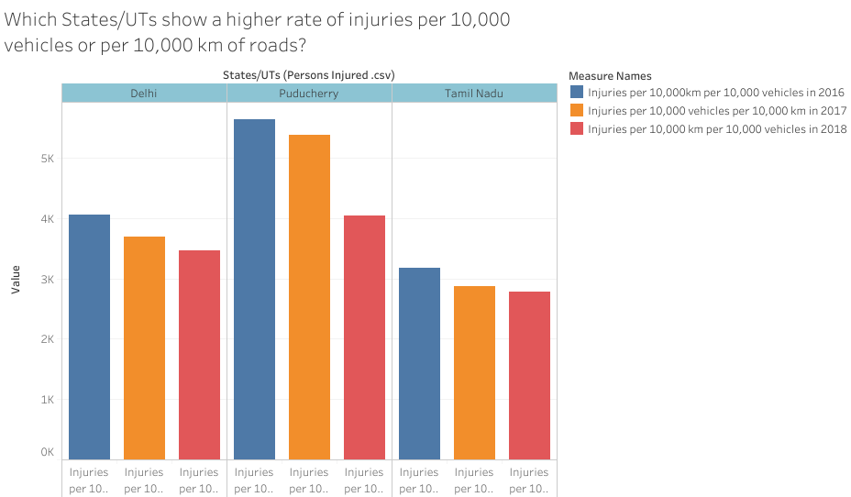
For Ut's it was once again Puducherry topping the charts with 5648,5389,4040 injuries per 10,000km and 10,000 vehicles in 2016,2017,2018 respectively; followed by Delhi with 4066,3699,3464 injuries for the same period.
Tamil Nadu topped the states charts with 3182,2881,2787 injuries for the same measure and same period.

Slide 10
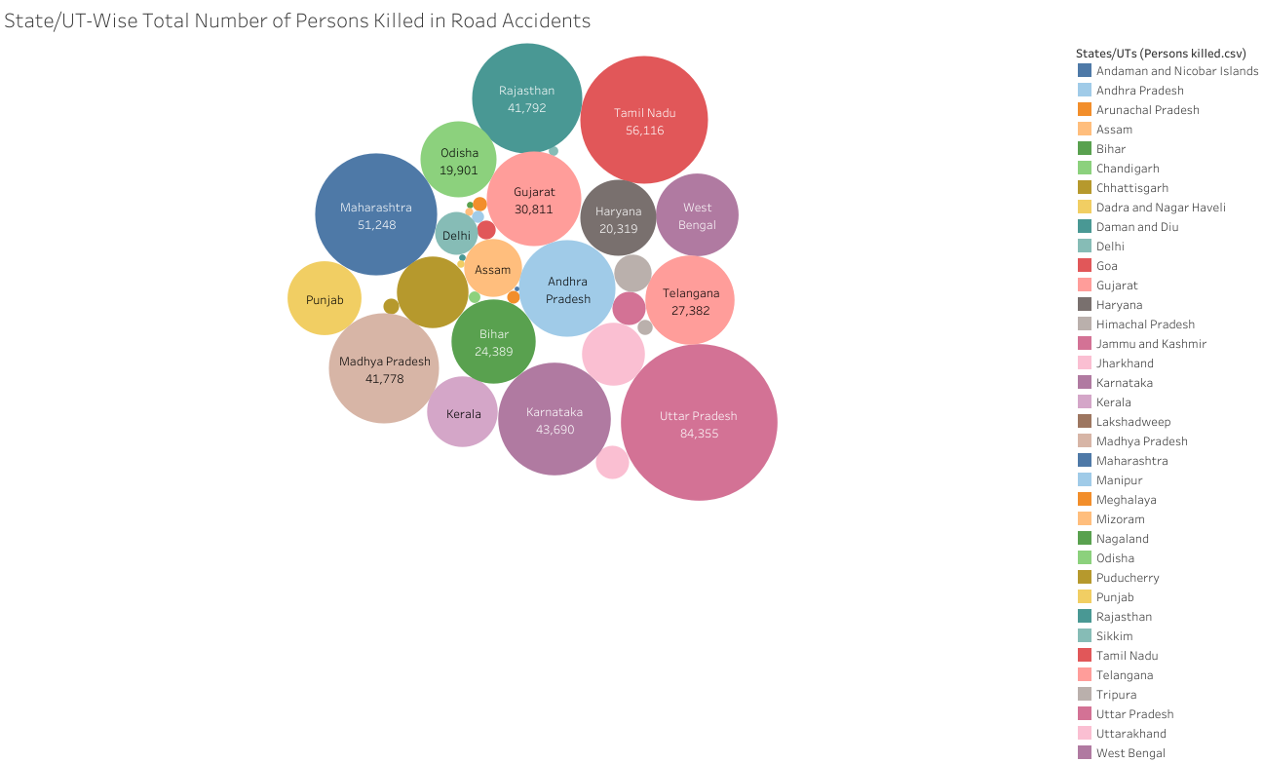
Up with
84,355 and
Delhi for Uts with
6,328
Fatalities
Over a four year period

Slide 11
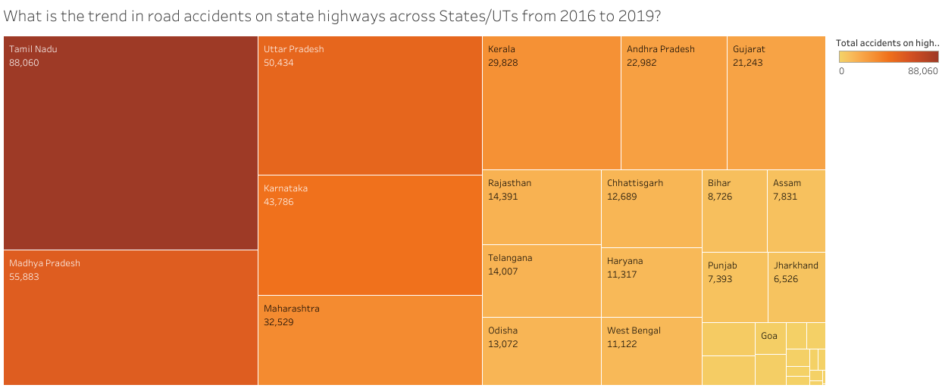
Tamil Nadu saw the most number of accidents with 88,060 over a 4 year period, while Mizoram saw the least with 90 accidents.
For UTs it was Puducherry with 868 and the lowest number was observed in Daman and Diu : 7

Slide 12
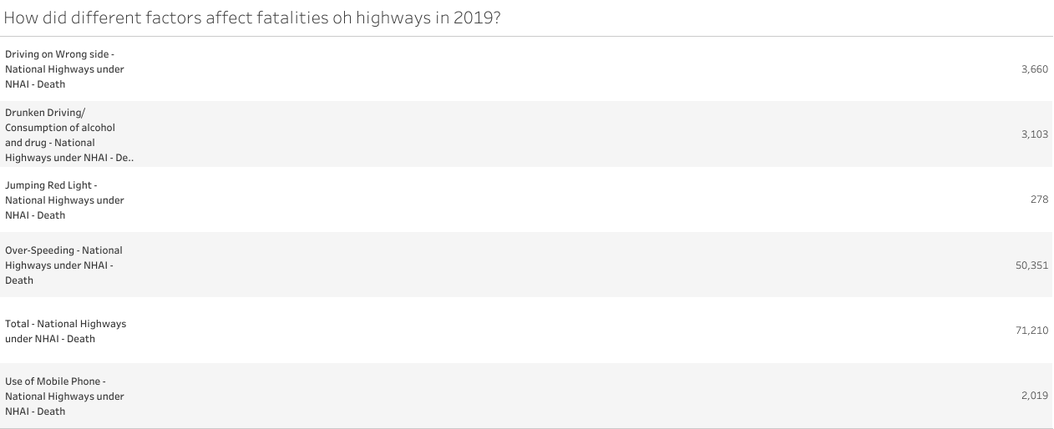
Per available data, in 2019 Over speeding on the national highways was the single largest cause of death leading to 50,351 deaths out of a total 71,210, an average of 195 deaths every 24 hours.

Slide 13
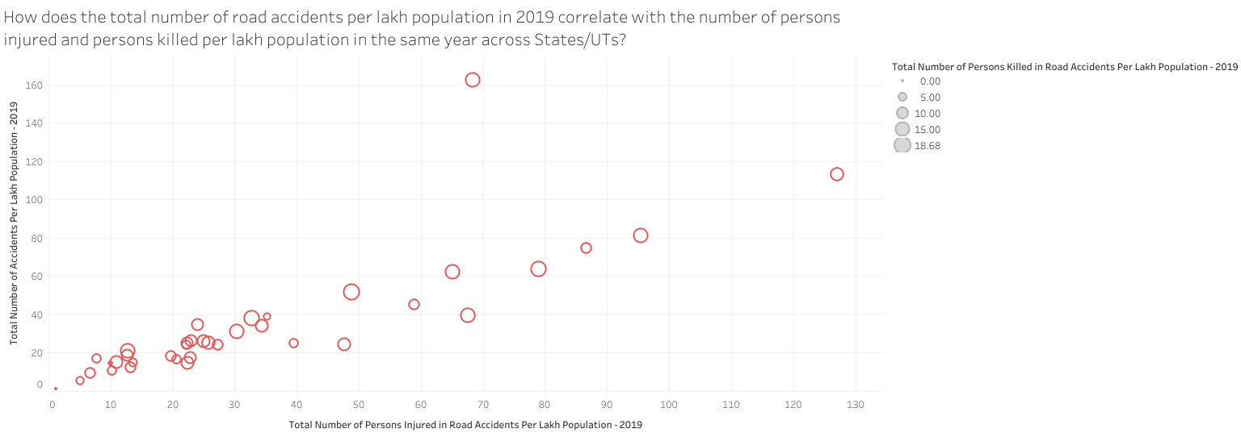
The state of Kerala topped the charts in this segment with following statistics:
Total Number of Accidents Per Lakh Population - 2019: 113.4
Total Number of Persons Injured in Road Accidents Per Lakh Population - 2019: 127.1
Total Number of Persons Killed in Road Accidents Per Lakh Population - 2019: 12.25

Slide 14
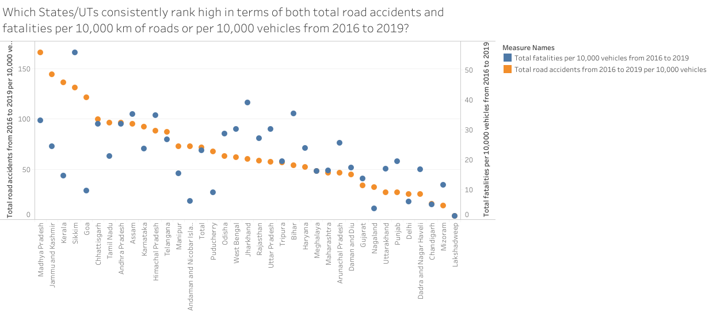
Madhya Pradesh topped the chart in following category: Total road accidents from 2016 to 2019 per 10,000 vehicles: 166.2
While Sikkim topped the chart for fatalities per 10,000 vehicles with 55.79 deaths

Slide 15
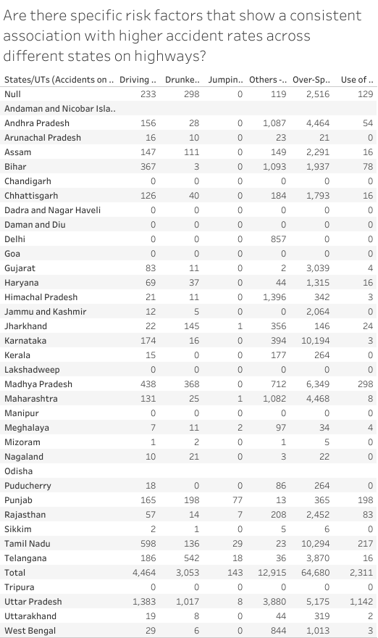
Over-speeding was found to be the biggest cause of accidents in 2019 with a staggering 64,680 cases being recorded.

Slide 16
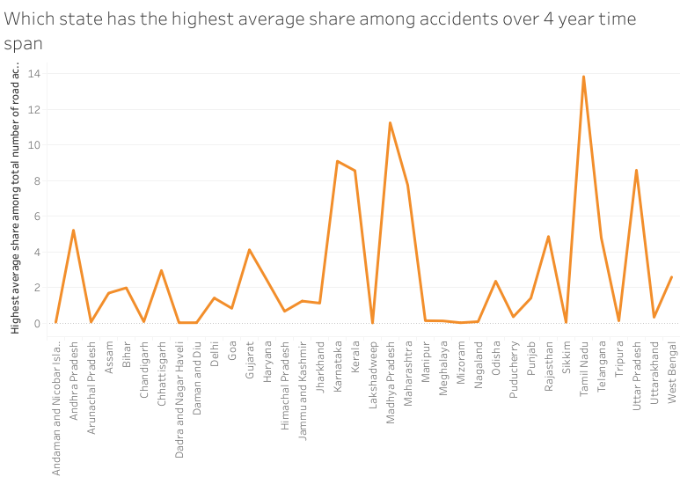
Between 2016 and 2019, the state of Tamil Nadu had the highest average share of accidents with 100 accidents.

Slide 17
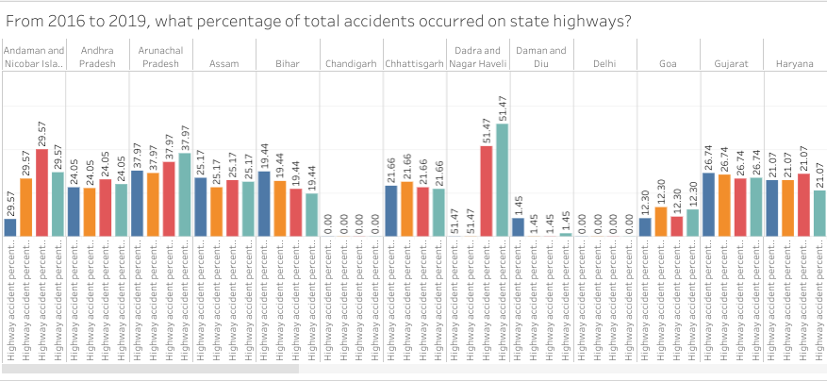
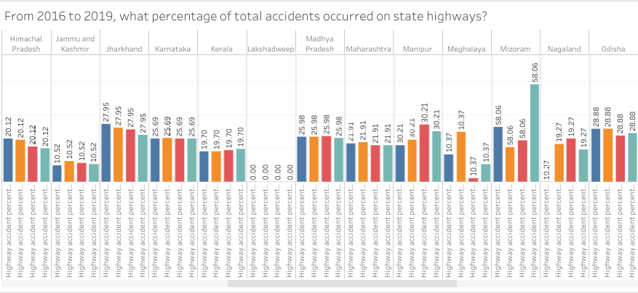
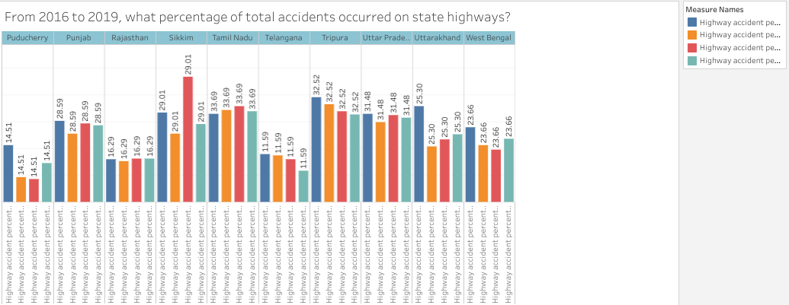
Tripura leads the chart for 2016 with 38.96% and for 2017 with 36.38%
Sikkim leads the chart for 2018 with 46.67%
Mizoram leads the chart for 2019 with 58.06%

Slide 18
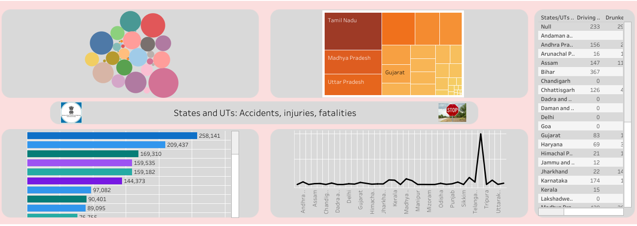
Above is the dashboard for the investigative analysis that was carried out.
It contains accidents in a specific period and a four year period along with highest average rate, also has the number for fatalities that occurred along with violations.

Slide 19
Conclusion
The average number of lives lost in accidents in 2019 was 195 affirming it as one of the single most important concern in the lives of our people.
The state of Tamil Nadu has seen the most number of accidents in a 4 year period while also suffering from a staggering fatality rate.
The Union Territory of Puducherry has been the single biggest contributor from the UT category even dwarfing Delhi in most cases.
Over-speeding on National highways was the leading cause of accidents in 2019. Out of a total 87,566 cases 64,680 belong to this category. Curbing the speed could reduce accidents by 73.86%.
Ministry is suggested to implement measures like speed cameras, speed traps and training officers with speed gun.
Measures to curb the speed of the vehicles could go a long way in securing the lives of people.

